Slide 1
Dialog System
Ivan Ropero García

Slide 2
What is a Dialog System?
It is a computer system that aims to establish communication with a person

Slide 3
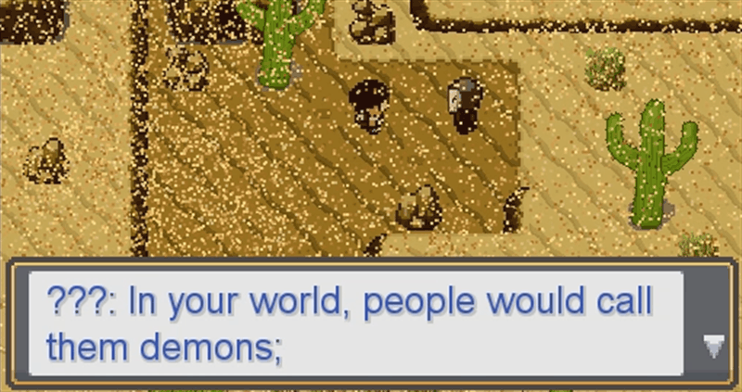
Dialog Systems in Video Games
Non- Branching Dialog
Linear Structure
Driven dialog
Limited interaction

Slide 4
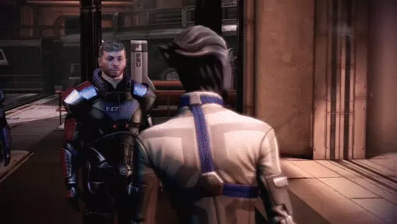
Dialog Systems in Video Games
Branching Dialog
Tree structure
Different possibilities
More immersion
Versatile system

Slide 5
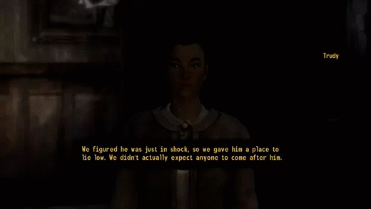
Dialog Systems in Video Games
Hub Dialog
Variant of the Branching System
Player can return to previous decisions
It gives more information to the player
Less immersive

Slide 6
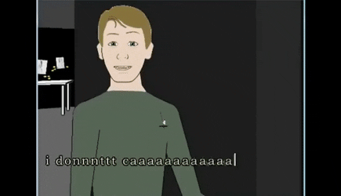
Dialog Systems in Video Games
Parser Driven Dialog
Maximum freedom for the player
Complex to implement
Hard to make it function correctly
Easy to break the immersion

Slide 7
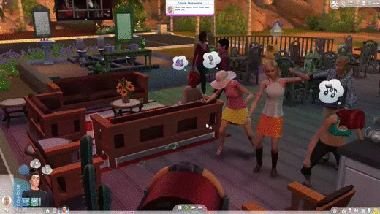
Dialog Systems in Video Games
Other remarkable dialog systems
Communication by symbols
More dynamic conversations
Player doesn’t have the control

Slide 8
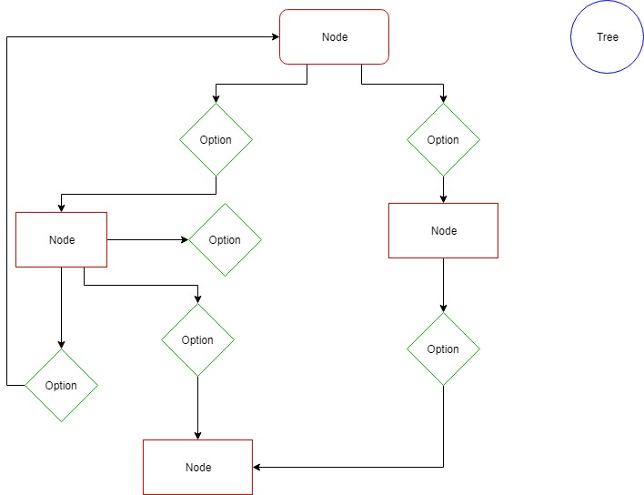
Which we will use?
Branching Dialog
We can switch between:
Non-Branching system
Branching system
Hub system
Versatile system

Slide 9
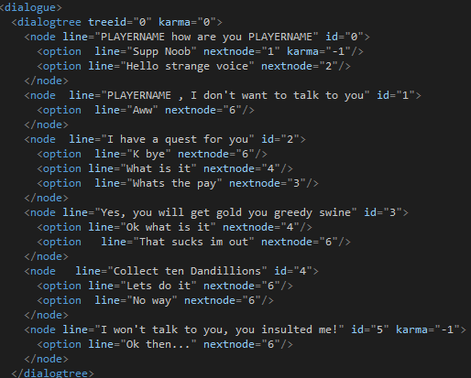
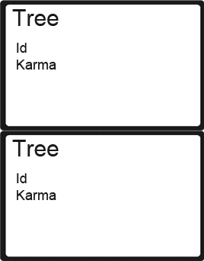
Ways to define the data

Slide 10
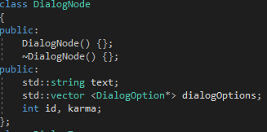
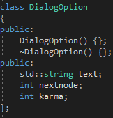
About classes

Slide 11
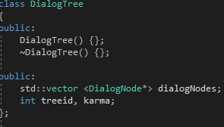
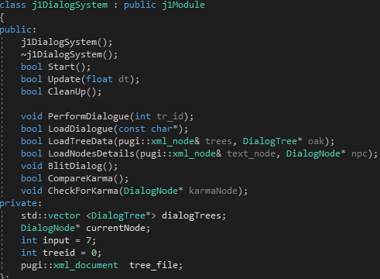
About classes

Slide 12
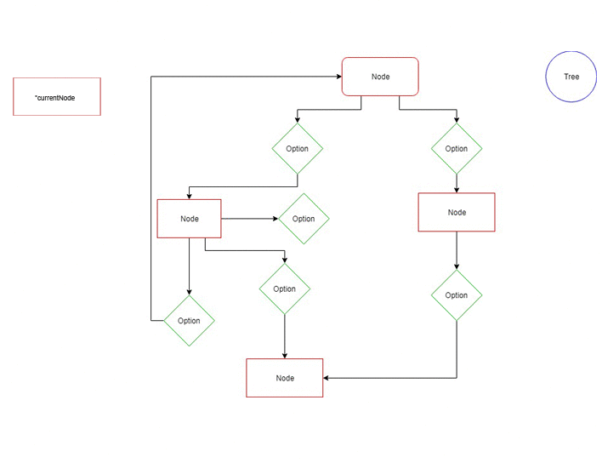
How it works
Load the XML
Take the input of the player
Search which node has the id of the option
Assign this node to a Dialog Node pointer
Print it on screen

Slide 13
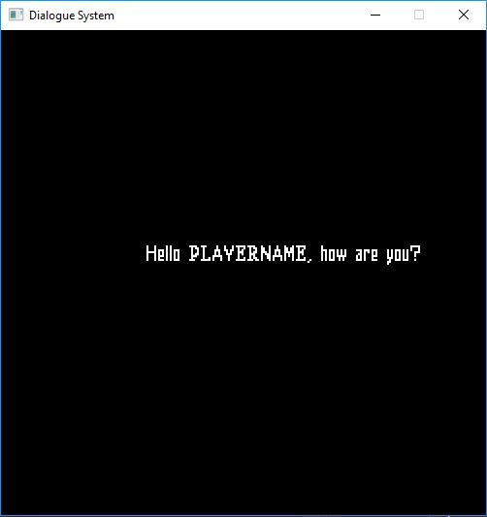
TODO: 1 Load the data from the XML
Load the information
Call the function LoadTreeData and LoadNodeDetails respectively
Push to their list

Slide 14
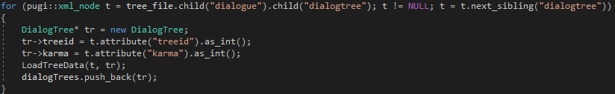
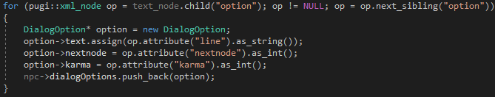
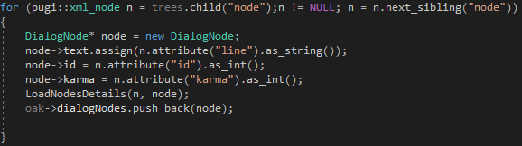
TODO: 1 Solution

Slide 15
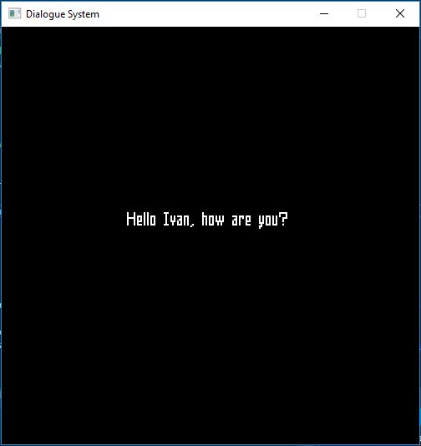
TODO: 2 Put the player name in the dialog
Create a size_t variable (a variable capable of representing the size of any object)
Put a condition that will only be fulfilled if you find the word PLAYERNAME (use std::string::npos)
Now substitute the word for the name we want to put our character
Remember to use the find and replace functions to complete this TODO

Slide 16
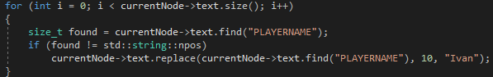
TODO: 2 Solution

Slide 17
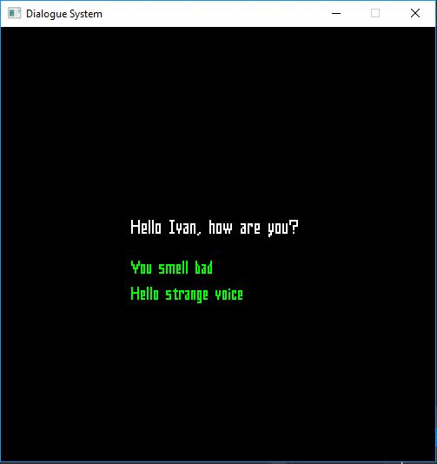
TODO: 3 Put your own dialog options
Now complete the first node with your own options.
The TODO is in the Dialog.xml file.

Slide 18
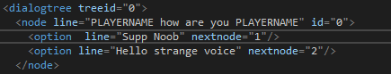
TODO: 3 Solution

Slide 19
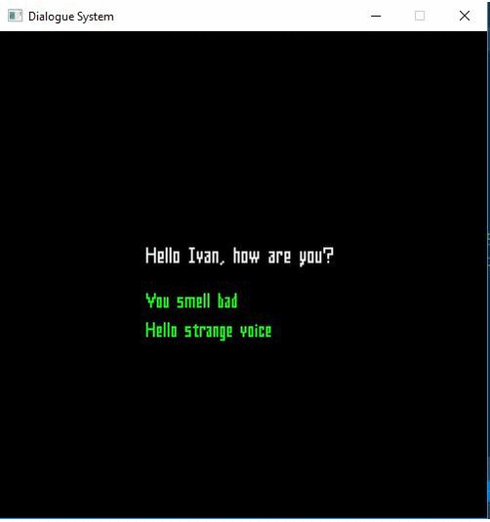
TODO: 4 Search which will be the next node
Search through all the nodes
Compare the nextid of the option taken and the rest of
the nodes
Assign the node found to currentNode

Slide 20
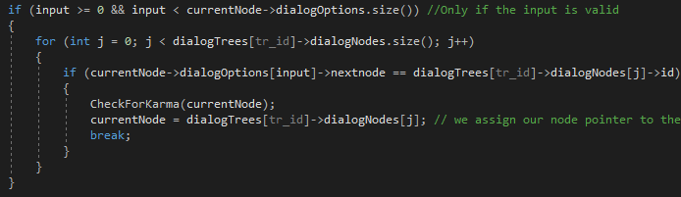
TODO: 4 Solution

Slide 21
TODO: 5 Write a bad option to say and a node with the NPC’s angry response
The TODO is in the Dialog.xml file
Write something bad to say to the NPC
Write a new Node where the NPC doesn’t want to talk to us
Karma values: neutral = 0 / angry = -1

Slide 22
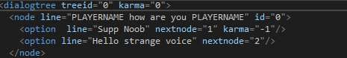
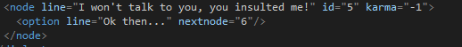
TODO: 5 Solution

Slide 23
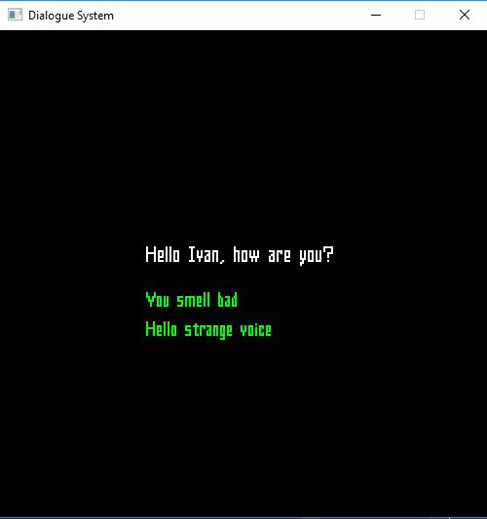
TODO: 6 Check the karma of the player
We will use 2 functions:
CompareKarma = karma is negative?
CheckForKarma = update tree karma
If the karma is negative assign the node with bad karma value

Slide 24
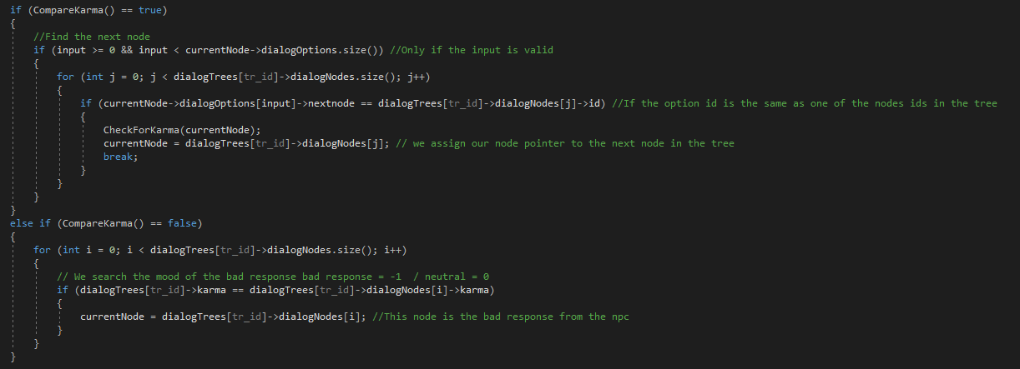
TODO: 6 Solution

Slide 25
What can we improve?
The input is very limited
A state machine would help to handle different tags
Match the dialogues with the UI

Slide 26
Thank you for your attention
Contact me at:
Github: RoperoIvan
Mail: ivan_ropero98@hotmail.com

